Slide 1
Computer Vision - Day 2
Dr Prashant Aparajeya

Slide 2
Dropout
Dropout is a regularization technique that helps prevent overfitting by randomly “turning off” (i.e. setting to zero) a fraction of a layer’s activations during training.
In essence, by temporarily removing some neurons on each forward pass, the network is forced to learn redundant, robust representations that do not overly rely on any single neuron.
This idea has proven especially useful in deep networks where overfitting can be a major problem.

Slide 3
Dropout in CNN
Why Use Dropout?
Prevent Overfitting: By randomly dropping neurons during training, dropout reduces the chance that the network memorizes the training data.
Reduce Co-Adaptation: Neurons cannot rely on the presence of particular other neurons to detect specific features, so they learn more general features.
Special Considerations in CNNs:
Spatial Correlation: In convolutional layers, adjacent pixels (or features) are highly correlated. Dropping individual neurons (as in fully connected layers) might not be as effective because nearby activations still carry similar information.
Dropout2d: For CNNs, it is common to use a “channel-wise” dropout (implemented as nn.Dropout2d in PyTorch) that zeroes out entire feature maps rather than individual elements. This helps to force independence across channels and better regularize the convolutional features.
For example, you might see dropout applied after a pooling layer or after a convolutional block to reduce overfitting while preserving spatial structure.

Slide 4
How Dropout Works in PyTorch
During Training: When you call model.train(), dropout layers randomly zero out elements with a specified probability (e.g., p=0.5). To maintain the overall magnitude of the activations, the surviving elements are scaled by a factor of 1/(1−p) so that the expected sum remains the same.
During Evaluation: When you switch to evaluation mode using model.eval(), dropout is automatically deactivated; the layer acts like an identity function and no neurons are dropped. This ensures that at test time all the learned features are utilized.
Dropout vs. Dropout2d:
nn.Dropout is typically used for fully connected (linear) layers where each neuron is dropped independently.
nn.Dropout2d (or spatial dropout) is designed for convolutional layers and drops entire channels (feature maps) at once. This is beneficial for CNNs where spatially adjacent pixels share a lot of information.

Slide 5
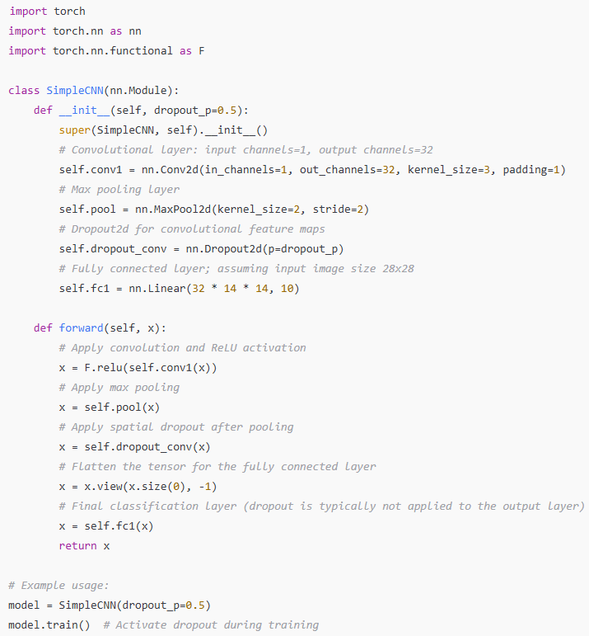

Slide 6
Dropout
Dropout is used to prevent overfitting by randomly disabling neurons during training.
In CNNs, it is more effective to use dropout methods like Dropout2d, which drops whole channels, because of the spatial correlations in convolutional features.
PyTorch offers both nn.Dropout (for linear layers) and nn.Dropout2d (for convolutional layers) with automatic behavior switching between training and evaluation modes.
When building your model, you typically insert dropout layers after activation or pooling layers (and before fully connected layers, if desired) to improve generalization

